Slide 1
Assessing Lupine as an Environmental Conservation Tool in Iceland
Gabe Brown, Tiffany Foote, Wil Michels, Nishan Grandhi
Notes:
Wil - 0:18

Slide 2
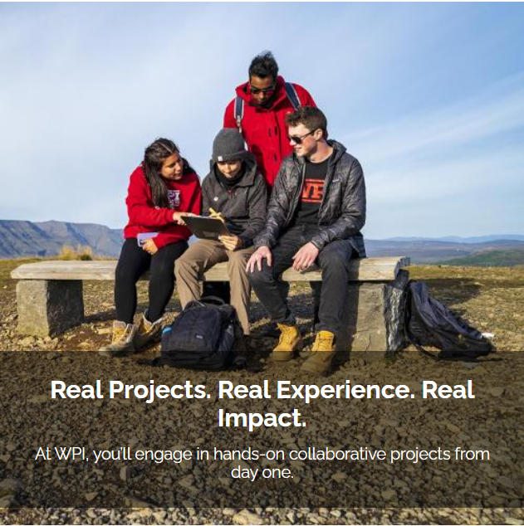
WPI Interactive Qualifying Project
Every WPI student completes an Interactive Qualifying Project (IQP)
Provides primarily STEM students with valuable social science experience
Most projects are international
In 2023, 24 students completed 6 different projects in Iceland
Notes:
Wil

Slide 3
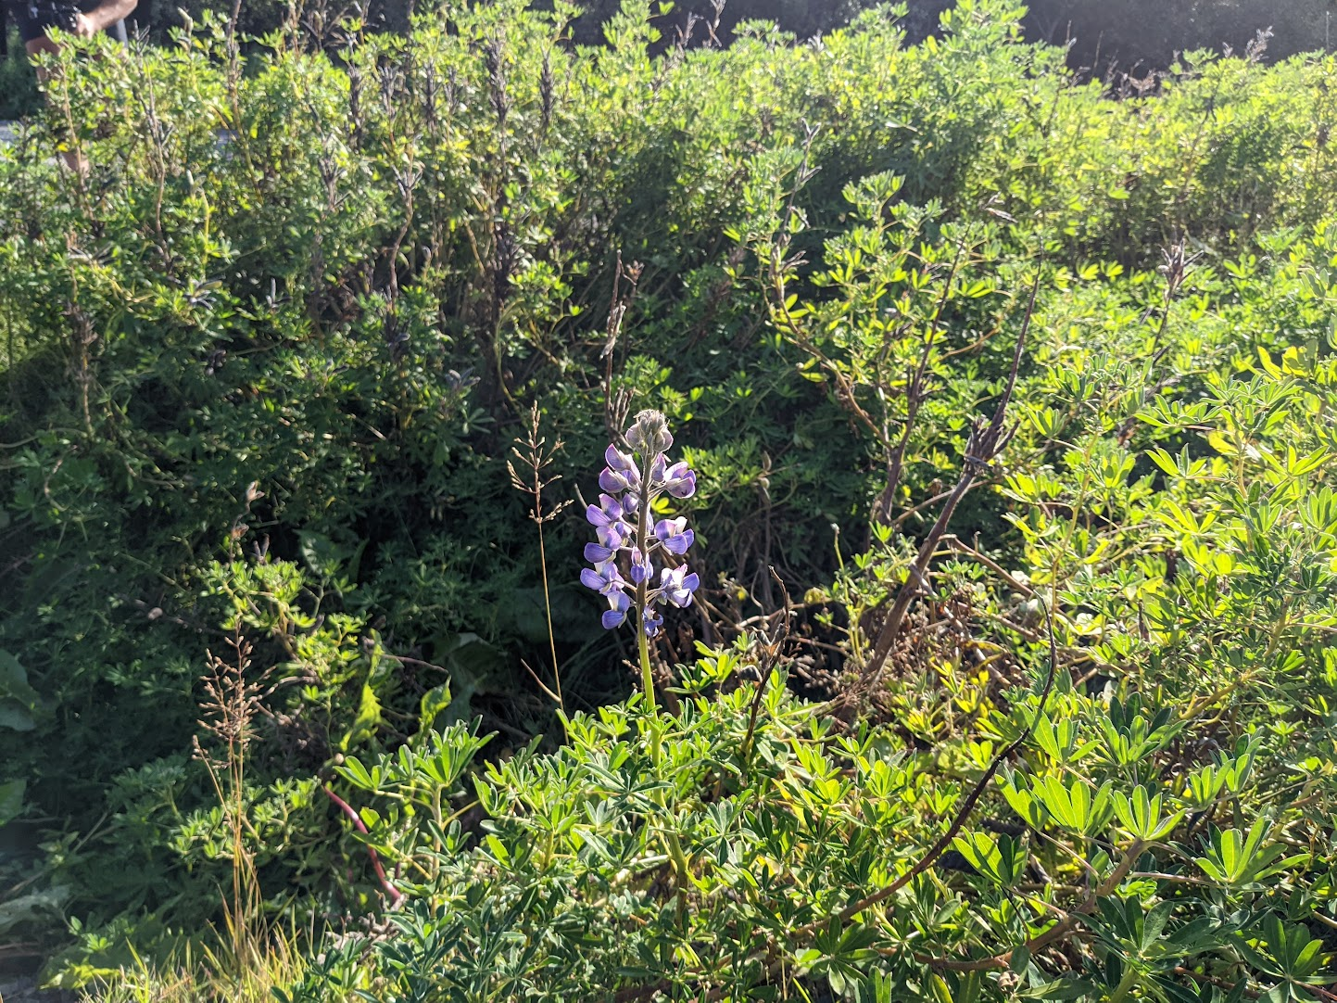
The Lupine Plant
Lupine introduced in 1945 as a reforestation tool
  Helps tree growth with nitrogen-fixing capabilities
  Has become invasive and reduces biodiversity
Lupine is a divisive issue
  Large pro and anti lupine groups
Notes:
Gabe - 1:00
Lupine was introduced to Iceland in 1945 by the Icelandic Forestry Service to help reforest Iceland.
Lupine is great at adding nutrients to soil and preventing soil erosion. It has been a huge help to the reforestation effort in Iceland, making tree growth possible at a fraction of the cost and carbon footprint of other solutions like stabilization blankets and fertilizer.
However, lupine is also quite invasive. Throughout Iceland invasive lupine reduces biodiversity and wipes out vulnerable native species like berries and herbs.
This has lead to extreme debate on the use of lupine. In addition to widespread public debate, 2 main government-sponsored organizations stand on either side of the issue.
The Icelandic Forestry Service, which brought lupine to Iceland, believes that it’s not actually invasive and is crucial for reforesting Iceland.
The Soil Conservation Service of Iceland, on the other hand, says that it’s extremely invasive and that alternative native plants can do a better job of stabilizing the soil without destroying ecosystems.

Slide 4
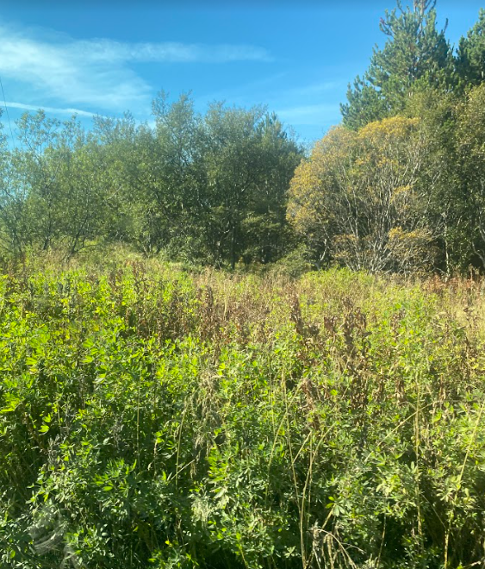
The Icelandic Landscape
Widespread viking deforestation
Iceland’s volcanic andisol soil lacks nutrients and is prone to erosion
  Native plants can help minimize erosion and add nutrients
Government’s goal is to increase environmental conservation
  Carbon neutral by 2040
Notes:
Gabe - 1:08
Restoration not reforestation
So why is Iceland’s environment so degraded? When Iceland was first being settled by vikings, they deforested huge parts of the country not realizing that tree growth in Iceland takes an extremely long time and that the trees were stopping the Island from eroding away.
This is due to the volcanic andisol soils that cover Iceland. This volcanic soil has very few nutrients and is very easily eroded, making plant growth challenging. This soil is primarily why lupine was brought to Iceland.
However, research has been done into non-invasive plants that can help with these soil deficiencies. Native lyme grass has been used to prevent soil erosion, while native white clover and non-native alder add nitrogen to the soil.
These plants all help with the government’s current environmental goals. The Icelandic government has the goal of becoming carbon neutral by 2040, with 3 specific goals leading to this: restoring wetlands, land reclamation, and reforesting mt. hekla. It’s important to keep these government goals in mind while addressing reforestation and soil conservation along with public sentiment.

Slide 5
Problem Statement
Lupine is a widespread but divisive tool for restoration that has impacted the Icelandic ecosystem and landscape.
Notes:
Wil - 0:16
Arctic lupine is a divisive, but widespread, soil conservation method that has caused damage to native Icelandic flora and fauna.

Slide 6
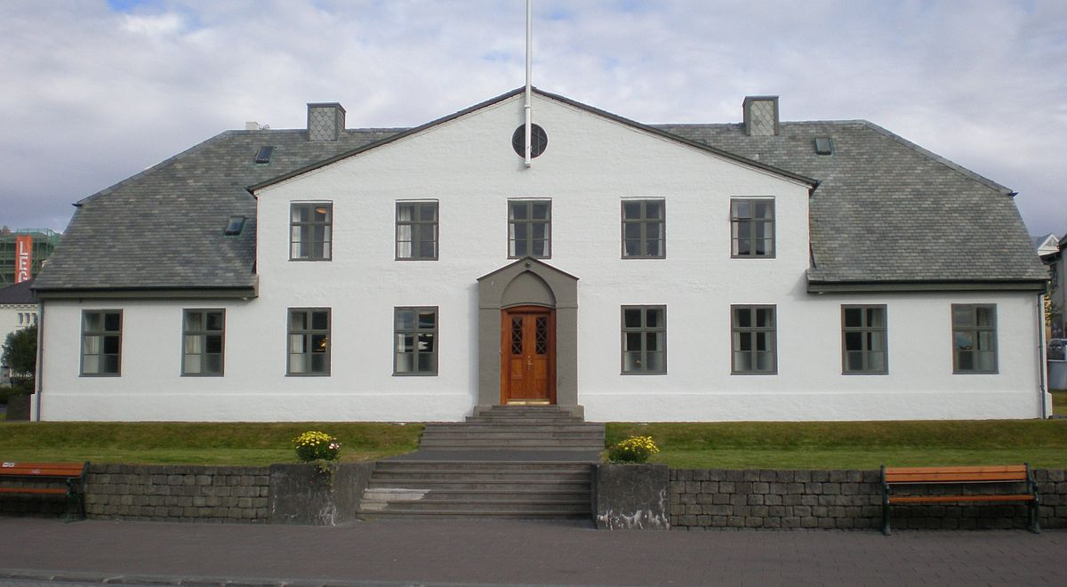
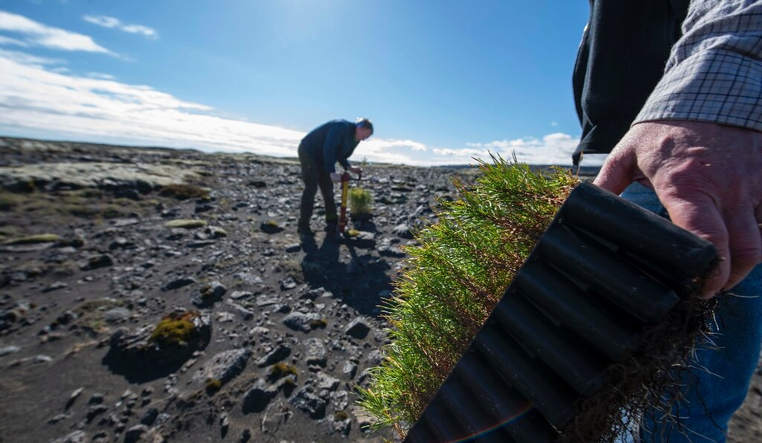
Research Question 1
What governmental, political, or social influences have promoted lupine as a soil erosion mitigation strategy?
Objective 1.1: Assess governmental policy and public opinion on using lupine as a tool for reforestation in Iceland.
Notes:
Nishan - 0:18

Slide 7
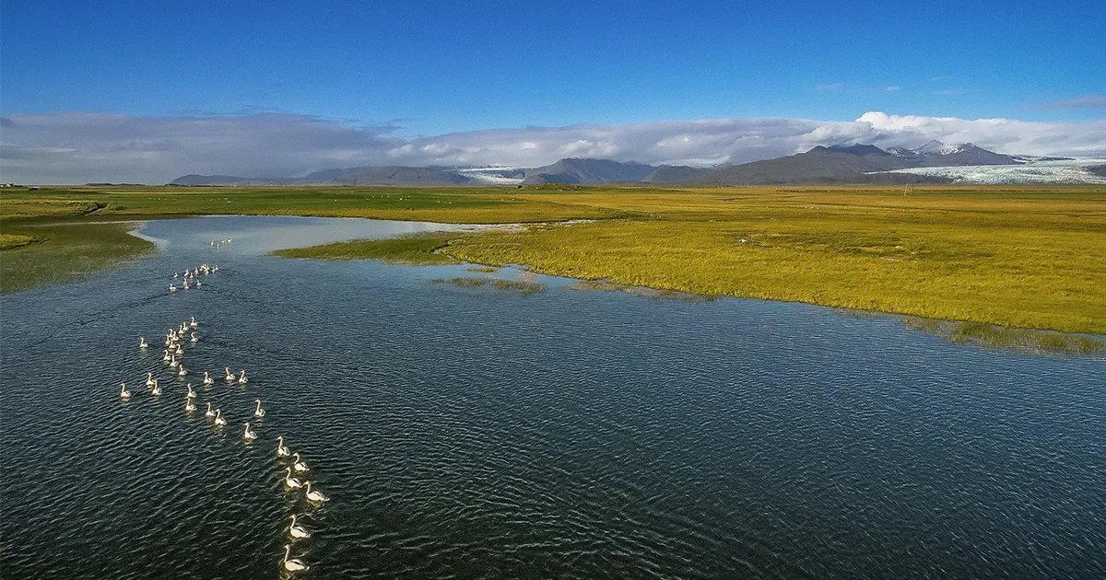
Research Question 2
What are the methods that promote restoration for varying conditions?
Objective 2.1: Evaluate methods to prevent soil erosion and add soil nutrients necessary for restoration and reforestation under different conditions in Iceland
Objective 2.2: Find and evaluate methods to control the spread of Lupine.
Notes:
Tiffany - 0:42
Our second research question is What are the methods that promote restoration for varying conditions? There are many different ecosystems that require different landscapes to thrive in Iceland. One is the wetlands which are currently releasing carbon dioxide as they have been severely eroded. Objective 2.1 was to evaluate methods to prevent soil erosion and add soil nutrients necessary for restoration and reforestation under different conditions in Iceland. To go along with that Objective 2.2 was to find and evaluate methods to control the spread of lupine.

Slide 8
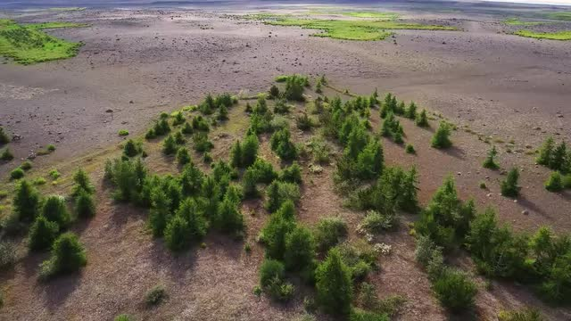
Research Question 3
What can be done to increase adoption of these varying restoration techniques?
Objective 3.1: Create a selection tool for viable restoration techniques in Iceland.
Notes:
Wil - 0:30

Slide 9
Methodology
Interviews and Surveys
Notes:
Nishan

Slide 10
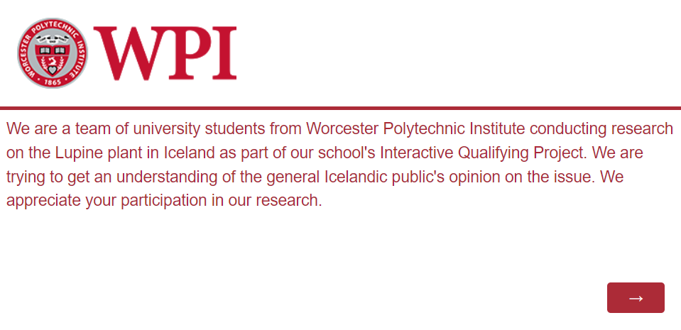
Surveys
In-Person and Online Surveying
  Surveyed at two Bónus locations
  Sent a survey to the r/iceland subreddit page
  Farmers newspaper sent survey out to landowners
Used Mógilsá State Forestry public survey
Notes:
Nishan - 0:30
Add information about the farmers survey
Explain BONUS PIG and wpi thing
Reference methodology

Slide 11



Interviews
Interviewed people from three organizations
  Icelandic Forestry Service
  Soil Conservation Service of Iceland
  Icelandic Farmers Association
Gave firsthand insight on the pros and cons of lupine
Notes:
Nishan - 0:21

Slide 12
Results
Interviews and Surveys
Notes:
Tiffany

Slide 13
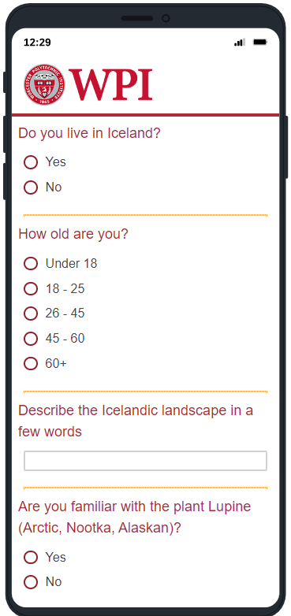
Public Survey
Collected a total of 48 results over four different days
Limitations
  Language barrier caused some confusion when surveying
  Uneven age demographic
Notes:
Tiffany - 0:34
For our first public survey we collected a total of 48 results over four different days at 4 different times in order to get the most variation in our results. Our main limitations were the language barrier of our survey being in written english and that there was a uneven age demographic specifically that only 10 people were above the age 45 years old.

Slide 14
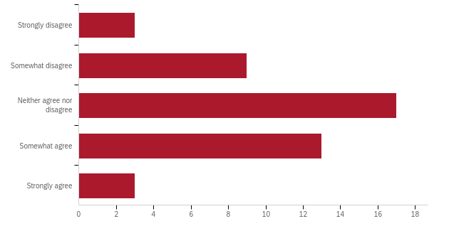
Public Survey
“Lupine has a positive impact on the Icelandic environment”
  Even split on the issue
  Significant generational divide, 50% neutrality for younger Icelanders and 25% neutrality for older Icelanders
Notes:
Gabe - 0:32
In our in-person survey, we saw the general public fairly split on the environmental impact of lupine. While the majority of respondents were fairly neutral on the impact of lupine, there was a huge generational divide on strength of opinions.
Half of younger Icelanders were neutral on lupine, while only 25% of older Icelanders were neutral.
This generational divide makes sense because older Icelanders have seen more of a change over time due to lupine, while younger people haven’t seen as much change.
The overall fairly even divide means we need to research both pro-lupine and anti-lupine solutions to reforestation and soil erosion.

Slide 15
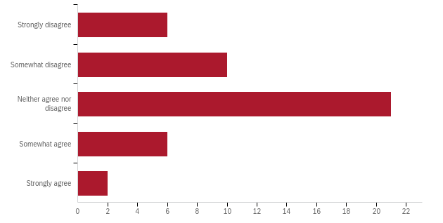
Public Survey
“Alien species like lupine do not belong in Iceland”
  Most of the results neither agreed or disagreed
  Few against alien species
Notes:
Gabe - 1:00
Another key survey result was Icelanders opinions on alien species. We found that the majority of Icelanders were not against species of plants simply because they are not native to Iceland. This is great, because almost all the trees being used to reforest Iceland are not native to Iceland.
In fact, there are only 4 tree species native to Iceland, all of which are very small, so using non-native trees to reforest is needed to have actual forests in Iceland.

Slide 16
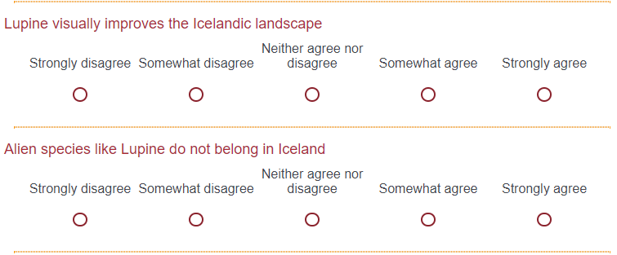
Online Reddit Survey
We sent our survey to the Iceland subreddit page
Collected a total of 46 results
Limitations
  People had access to the internet for the online survey
  Not all results necessarily reflect their opinion
Notes:
Wil - 0:47

Slide 17
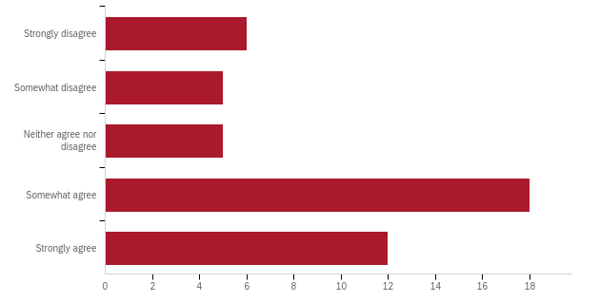
Online Reddit Survey
“Lupine has a positive impact on the Icelandic environment”
  More divided results than in-person survey, less neutral responses
  Heavily skewed positive
Notes:
Wil - 0:47

Slide 18
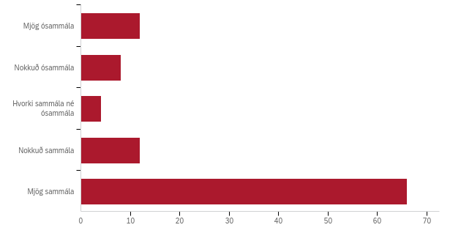
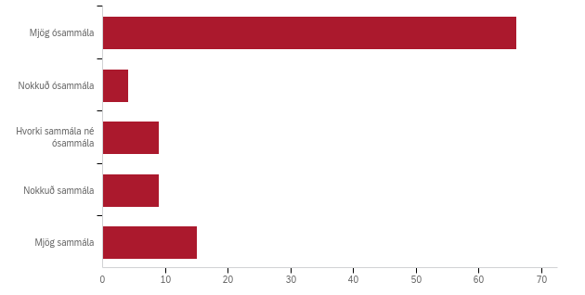
Farmers Newspaper Survey
Collected 100 responses
Limited analysis due to timing and translation
Results are heavily in favor of lupine
  Most responders use lupine and mention almost no downsides
“Lupine is a good tool for preventing soil erosion”
“Non-native species like lupine do not belong in Iceland”
Notes:
Wil - 1:05
Move to before the forestry survey
Comment on it being in Icelandic
Add the amount of results

Slide 19
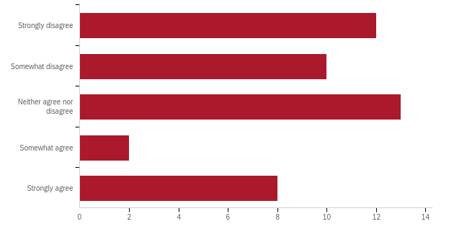
Our Survey Takeaways
Most people in Iceland are more opposed to using invasive species, while few Icelanders are opposed to using alien (non-native) plants.
Question: “Alien (non-native) species do not belong in Iceland”
Public Survey
Reddit Survey
Farmers Association
Notes:
Tiffany - 0:37
Although that we found a main public survey takeaways was that all the opinions on lupine were skewed depending on the group that was responding. One of the main commonalities we found as gabe said that most people were opposed to people using invasive plants in Iceland. While we found that few people are opposed to using non-native plants as shown at the bottom of the slide all the graphs are skewed in favor of indifferent to strongly disagree.

Slide 20
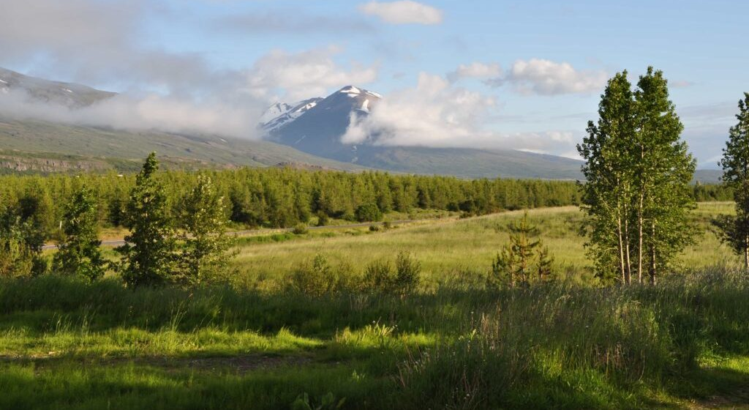
Forestry Survey
Utilized survey results from the Mógilsá State Forestry
  Gave a comprehensive view of the public’s opinions on forests and soil erosion
Limitations
  Results were from two decades ago, opinions may have changed
Notes:
Nishan - 0:31

Slide 21
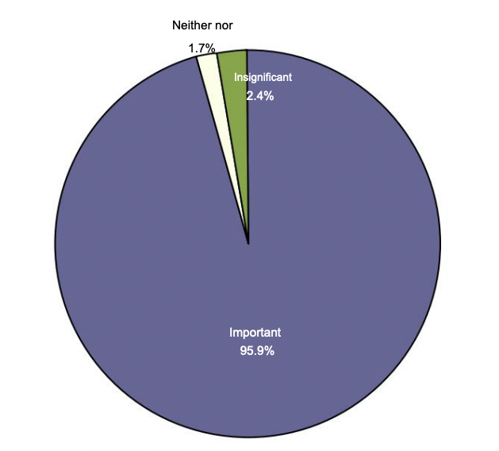
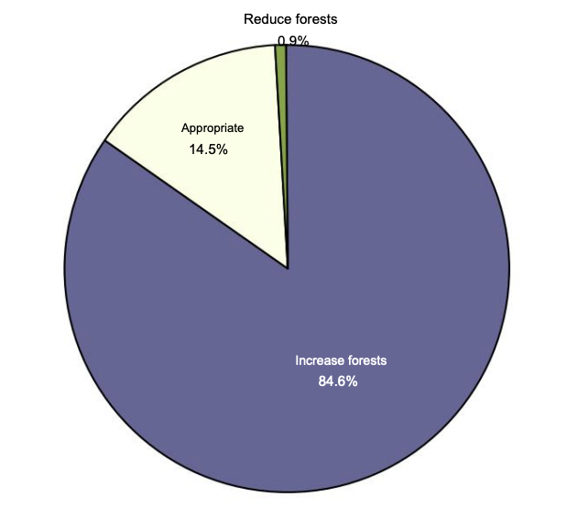
Forestry Survey
“How important or unimportant do you think it is to stop and prevent soil erosion?”
  95.9% said soil erosion is an important issue
“Would you like to increase or decrease the forests in this country or do you think the forests are suitable?”
  84.6% want to increase forests across Iceland.
Notes:
Nishan - 0:45

Slide 22
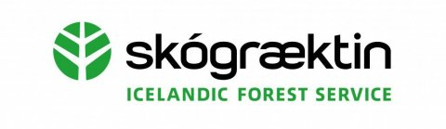
Forestry Survey Takeaways
The vast majority of Icelanders agree that fixing soil erosion, reforestation, and landscape restoration are important issues.
People want to increase forests across the landscape
  Open to new solutions on how to achieve this goal
Notes:
Tiffany - 0:30
The forestry survey showed that the three most important issues in Iceland was fixing the soil erosion, reforestation and landscape restoration in Iceland. People want to increase the amount of forests in iceland for many reasons one is recreational use. (find the other reasons)

Slide 23
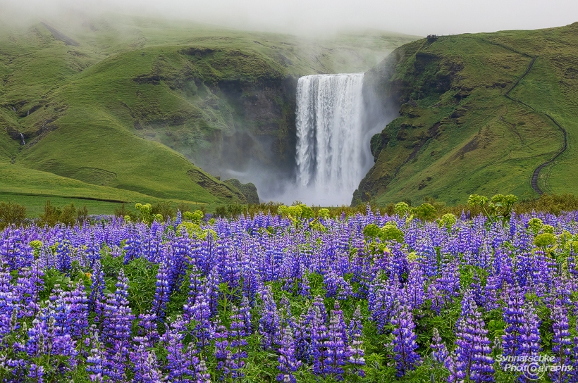
Interview Summary
Experts from 3 organizations interviewed
  Icelandic Forestry Service
  Icelandic Farmers Association
  Soil Conservation Service of Iceland
Lupine is great for reforestation efforts
Soil conservation can be done well with only native plants
Irresponsible sheep grazing can damage land
  Sheep grazing can remove lupine
Notes:
Gabe over two minutes too long - 1:45
We had interviews with experts from 3 different organizations who have different environmental goals for Iceland.
In general, experts agreed that lupine works extremely well for reforestation efforts. It adds way more nitrogen to the soil than any other plant that has been tried, and allows a huge variety of native and non-native trees to prosper in places where it would otherwise be impossible.
However, experts were divided on the role of lupine in soil conservation. While some thought lupine isn’t really invasive, others argued that primarily native species should be used and native ecosystems should be restored.
One result we didn’t expect from our interviews is the importance of sheep.
Every expert agreed that one of the biggest causes of soil erosion and land degradation is irresponsible grazing. When sheep farmers over-graze land, the plants are removed and the soil gets dramatically eroded. The rights for farmers to graze sheep wherever they want is apparently even more controversial than lupine.
The expert we interviewed the forestry service said sheep work great for getting rid of lupine, saying that lupine removal is easy with the simple introduction of sheep. Sheep farming definitely plays a big role in this issue in ways we did not expect.

Slide 24
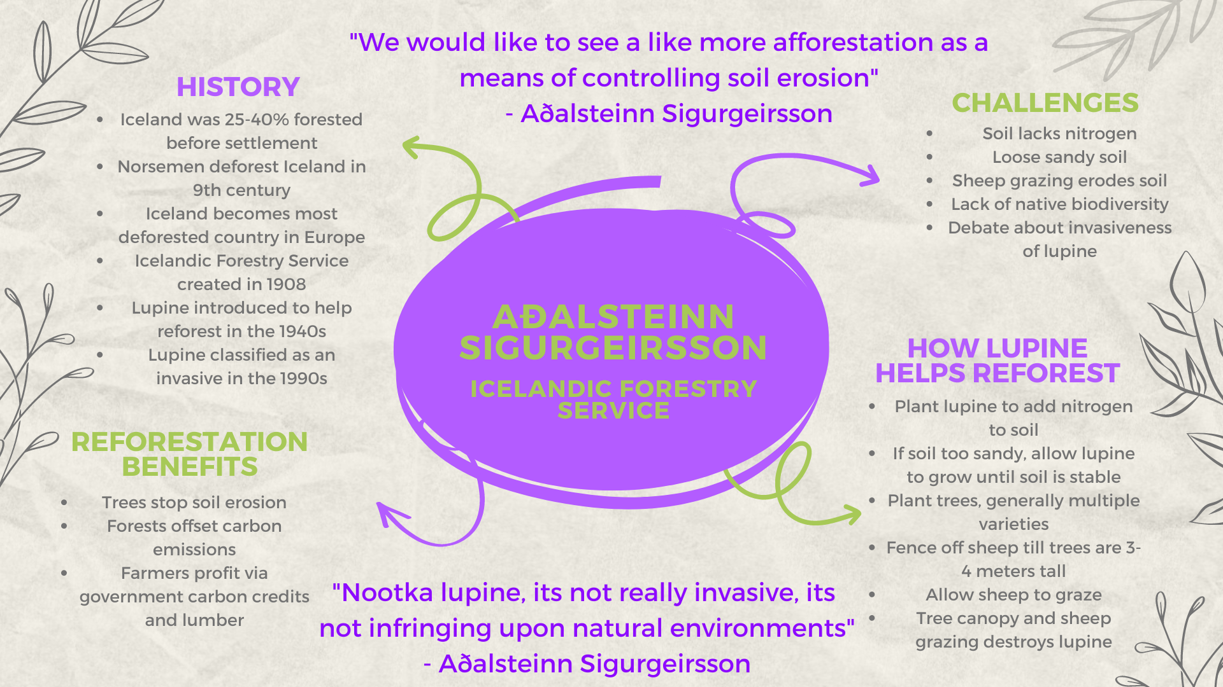
Notes:
Gabe - 0:45
We organized the information from each of the interviews in a mind map that breaks down the information to be easily readable.
This is the mind map from our interview with Adalsteinn Sigurgeirsson, the deputy director of the Icelandic Forestry Service. These mind maps can be found in our complete research paper on the WPI digital archive.

Slide 25
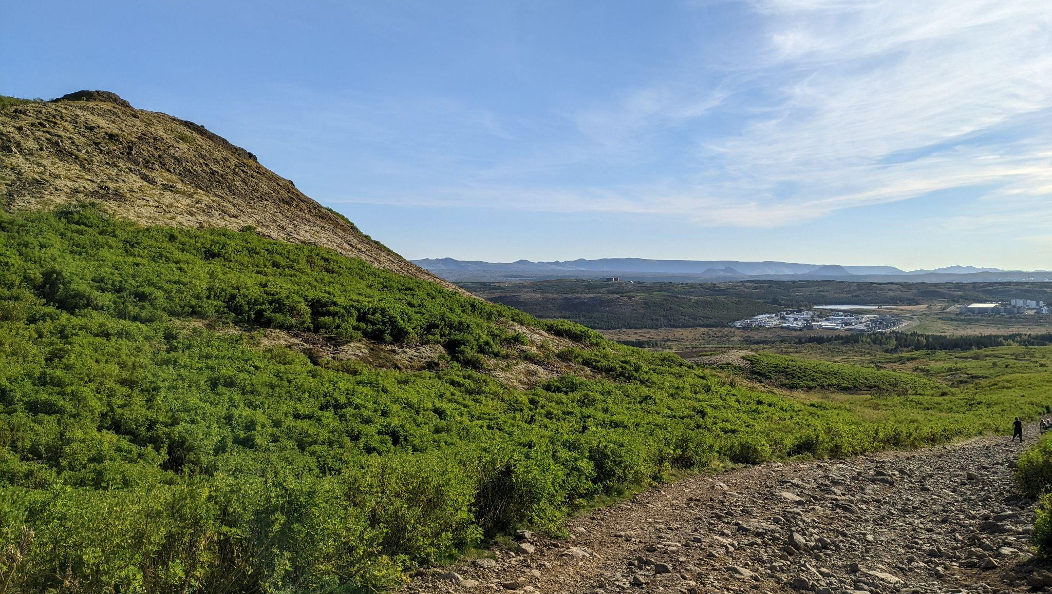
Observational Results
Notes:
Wil - 0:45

Slide 26
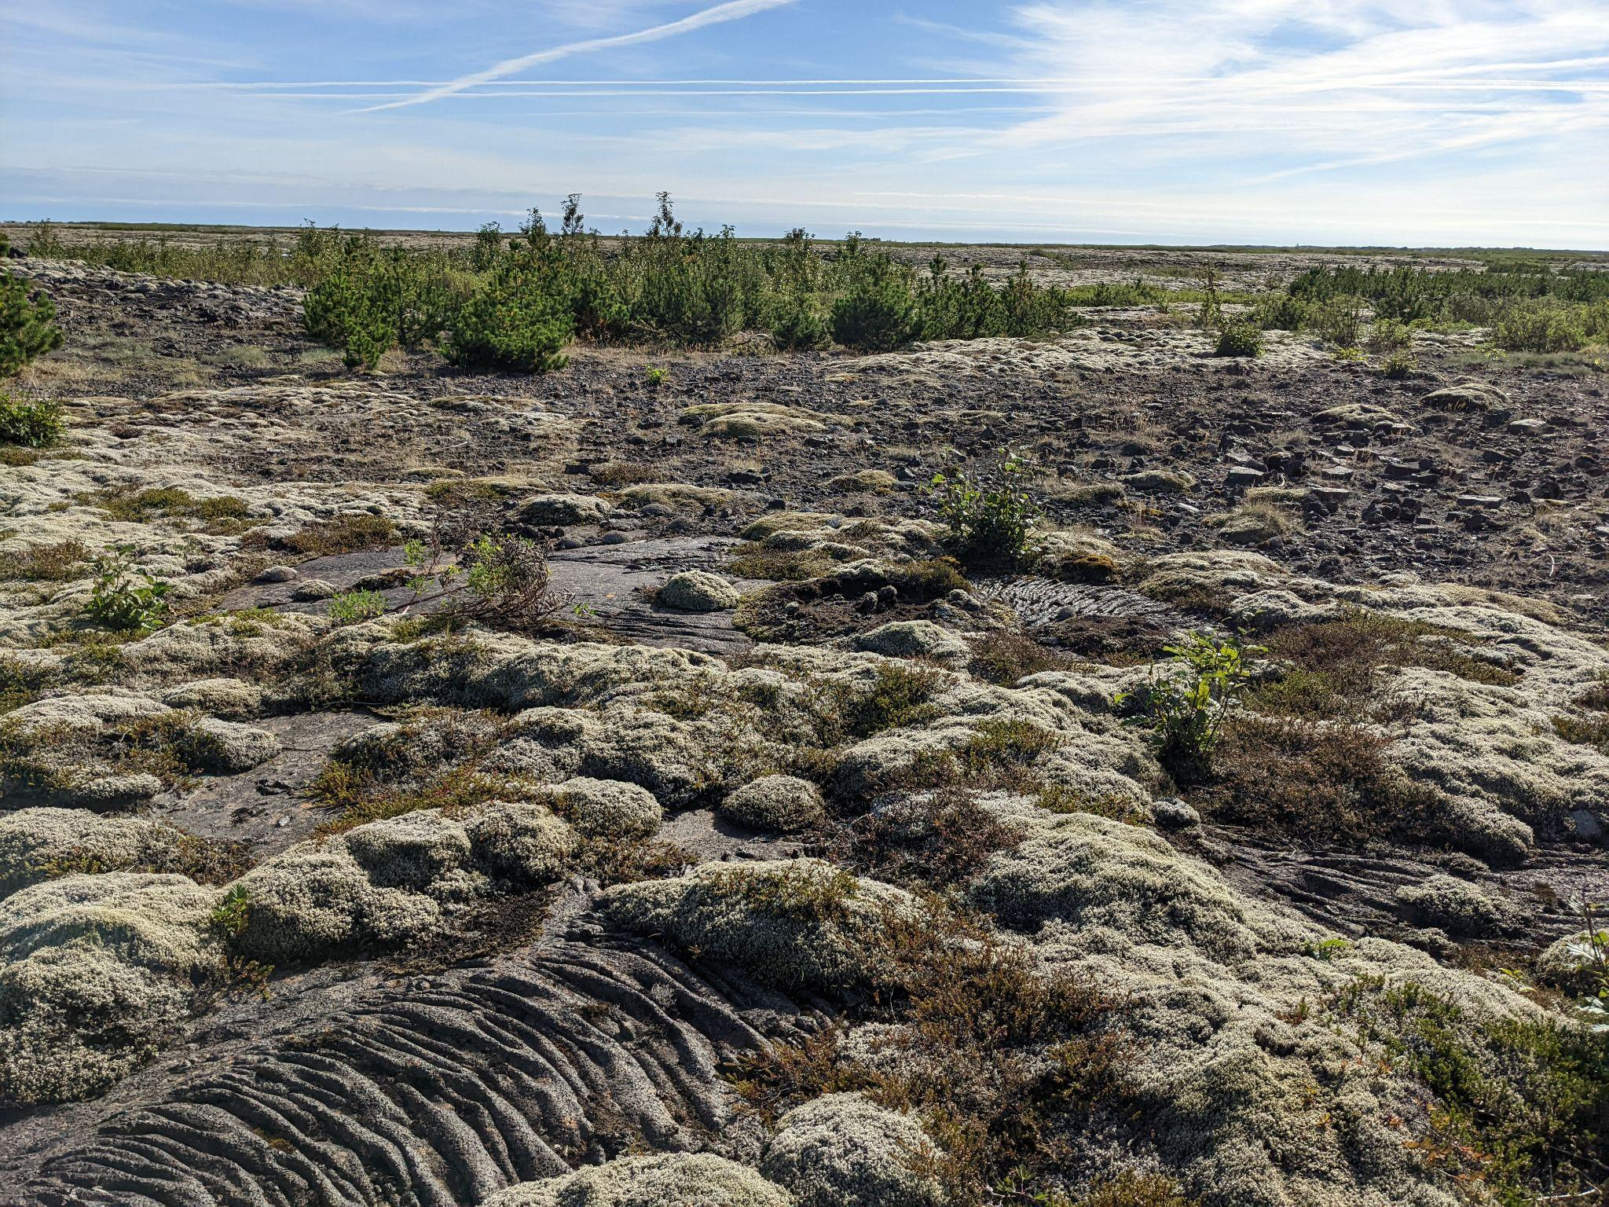
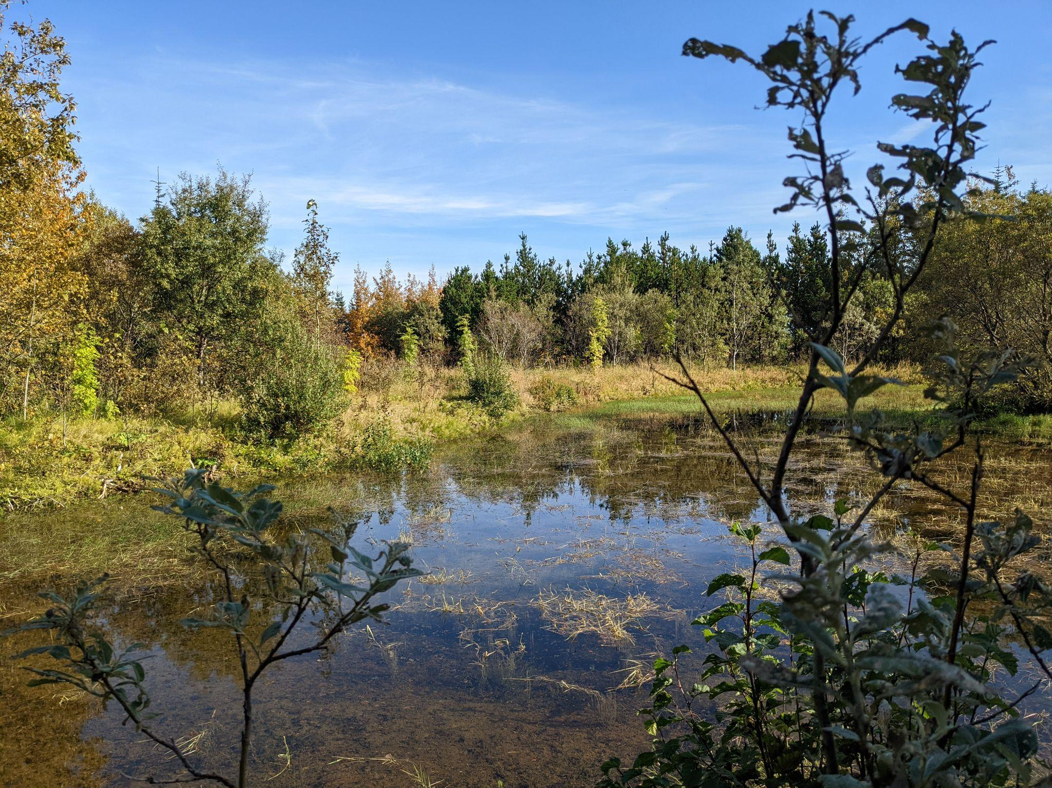
Observational Results
Notes:
Wil - 1:00

Slide 27
Recommendations
Decision Guide, Decision Balance Sheet
Notes:
Nishan

Slide 28

Decision Guide
There is not one solution for all land usage
  Our deliverable recommends to the user what is best for their conditions
Overarching question is “What is the goal for your land?”
  Reforestation
  Restoration
  Removal of Lupine
Canva and Typeform used to represent the information
Notes:
Nishan - 0:56

Slide 29
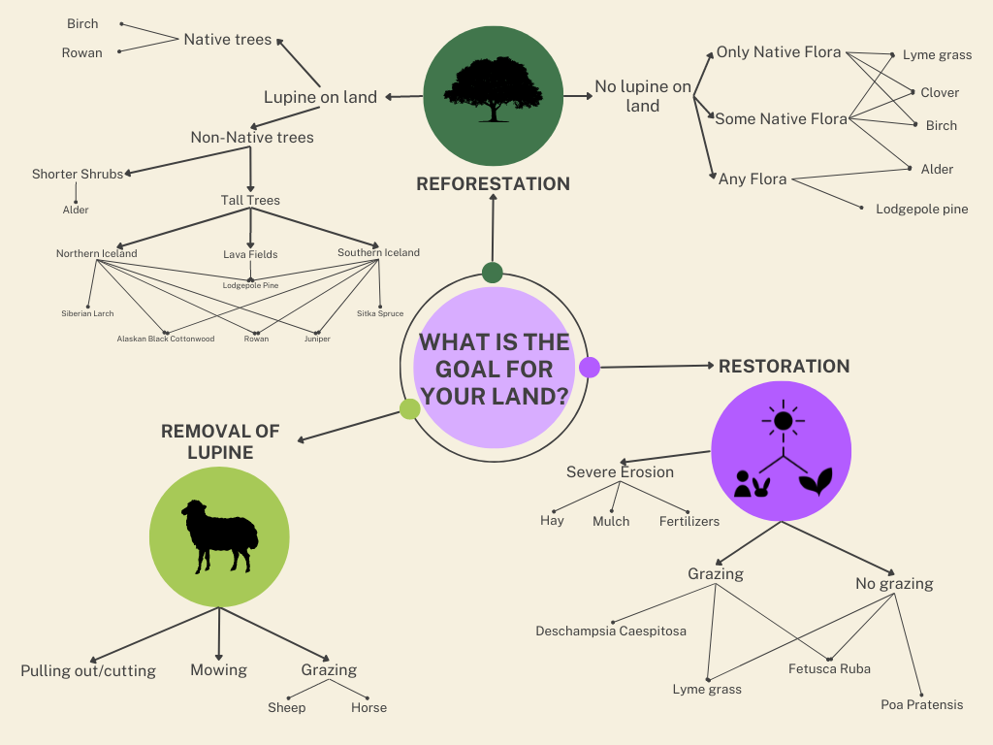
Notes:
Gabe - 0:28
Here you can see our decision guide with all the different restoration goals as well as the possible solutions.
To teach more about each of the plants seen here, we made an infographic with basic information on many of the species used for restoration. This decision guide and accompanying plant infographic can be found in our research paper online in the WPI digital archive.

Slide 30
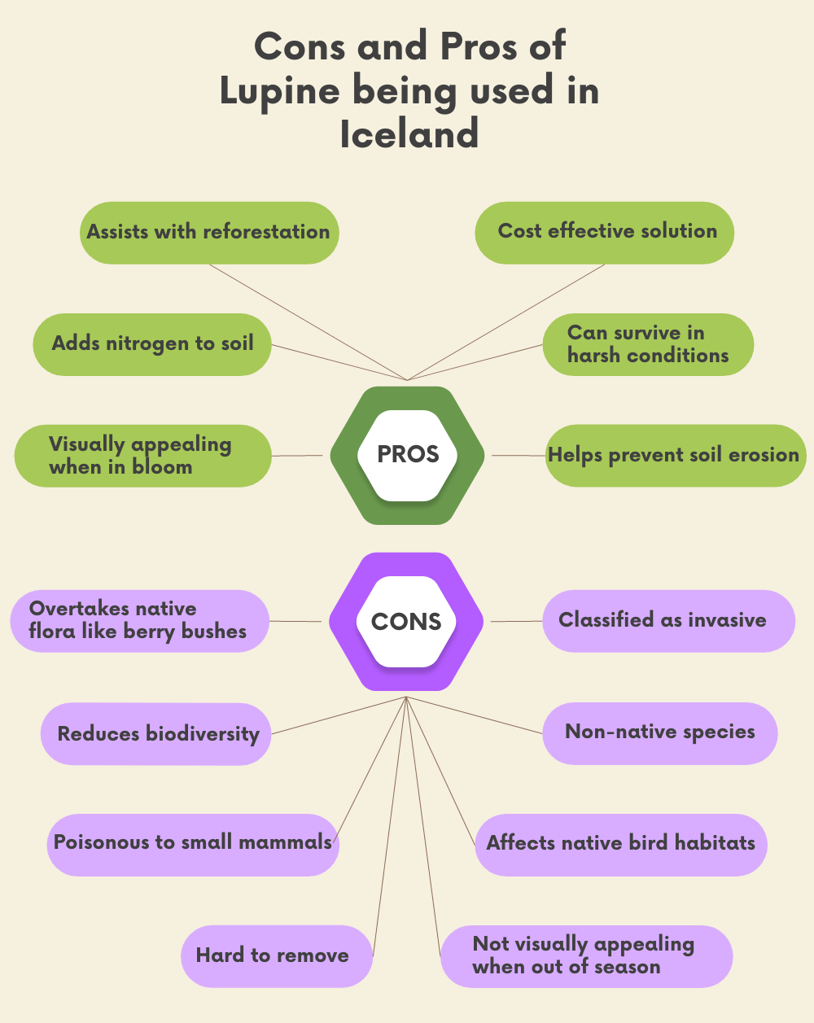
Decision Balance Sheet
Concise list of the most important attributes of lupine
Gives the reader a quick summary of the divisive nature of lupine
Notes:
Tiffany - 0:32
The decision balance sheet is an important list of attributes that are good and bad about lupine in Iceland. It is important because it gives a quick summary and every person can add or remove attributes that they do or do not need based off of their land.

Slide 31
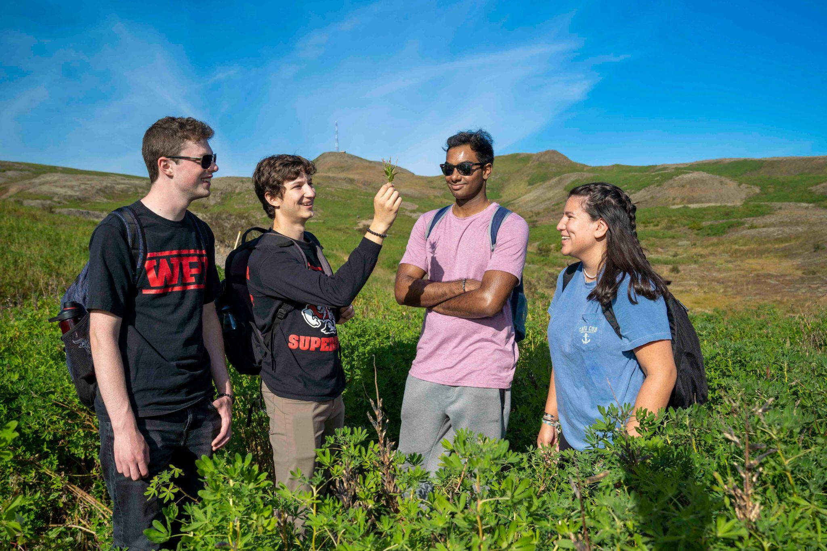
Conclusion
Covers restoration, soil erosion, and lupine control based off expert interviews and survey results from differing groups
For future projects, we think it may be best to split this project into multiple other projects
  "Soil Conservation and Sheep Grazing"
  "Reforestation With and Without Lupine"
  "Lupine Being Converted to a Crop"
Notes:
Tiffany - 1:00
Our decision guide and decision balance sheet covers restoration, reforestation, soil erosion and lupine control in Iceland. This was based off our expert interviews and survey results. These final deliverables were aimed towards the general public that way as many people as possible can use these materials. We felt that we were not able to go in depth in some of the topics within our project. Our project can be split into multiple smaller research sections. The first one we thought of is Soil conservation and sheep grazing another is Reforestation with and without lupine and finally our last idea was lupine being converted into a crop. During our research we found that there are a few groups in Iceland that are attempting to make lupine into a crop so that is can be used as a food, medicine or even being converted into plastics.

Slide 32
Thank you!
Questions?
Notes:
Nishan

Slide 33
Image Citations
https://www.google.com/url?sa=i&url=https%3A%2F%2Fen.wikipedia.org%2Fwiki%2FCabinet_of_Iceland&psig=AOvVaw19nHm2-SMb8yZxl0coa8BV&ust=1665412823866000&source=images&cd=vfe&ved=0CAwQjRxqFwoTCOjT-7Cw0_oCFQAAAAAdAAAAABAE
https://www.savingiceland.org/2006/03/thjorsarver-wetlands-is-the-heart-of-iceland-really-safe-from-the-nature-killers/
https://www.google.com/url?sa=i&url=https%3A%2F%2Fphys.org%2Fnews%2F2019-07-iceland-trees-razed-vikings.html&psig=AOvVaw0s8cj6Zdpz1CnOtPgVnYeQ&ust=1665412856382000&source=images&cd=vfe&ved=0CAwQjRxqFwoTCPCJx8Cw0_oCFQAAAAAdAAAAABAE
https://www.google.com/url?sa=i&url=https%3A%2F%2Fwww.nytimes.com%2Finteractive%2F2017%2F10%2F20%2Fclimate%2Ficeland-trees-reforestation.html&psig=AOvVaw0s8cj6Zdpz1CnOtPgVnYeQ&ust=1665412856382000&source=images&cd=vfe&ved=0CAwQjRxqFwoTCPCJx8Cw0_oCFQAAAAAdAAAAABAJ
https://www.google.com/url?sa=i&url=https%3A%2F%2Fbonus.is%2Fenglish%2F&psig=AOvVaw3s5JmhMCuAs9-R1ulAo3Om&ust=1665412927399000&source=images&cd=vfe&ved=0CAwQjRxqFwoTCJCJv-Kw0_oCFQAAAAAdAAAAABAD
https://www.google.com/url?sa=i&url=https%3A%2F%2Falfred.is%2Fstarf%2Fviltu-taka-thatt-i-graenni-framtid&psig=AOvVaw1ijDrJlHxwgCKdSfU4VOJ4&ust=1665412943213000&source=images&cd=vfe&ved=0CAwQjRxqFwoTCPjl4emw0_oCFQAAAAAdAAAAABAJ
https://land.is/heim/english/
https://www.bondi.is/english
https://www.google.com/url?sa=i&url=http%3A%2F%2Fglasgowexsoc.org.uk%2Fblogs%2Ficeland2015%2F2021%2F03%2F17%2Fare-there-trees-in-iceland%2F&psig=AOvVaw37qfT6HcXaCDBAh2uea_jn&ust=1665413073816000&source=images&cd=vfe&ved=0CAwQjRxqFwoTCNiZsKix0_oCFQAAAAAdAAAAABAE
https://www.google.com/url?sa=i&url=https%3A%2F%2Fwww.synnatschke.com%2Fnews%2Fbest-time-places-for-lupines-in-iceland&psig=AOvVaw0xxRIK52SPkanRyz7E-UrC&ust=1665413101173000&source=images&cd=vfe&ved=0CAwQjRxqFwoTCNC_mbWx0_oCFQAAAAAdAAAAABAE

